Slide 1

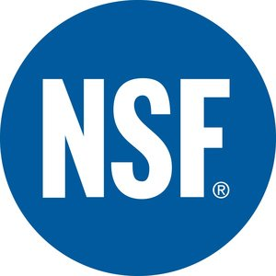
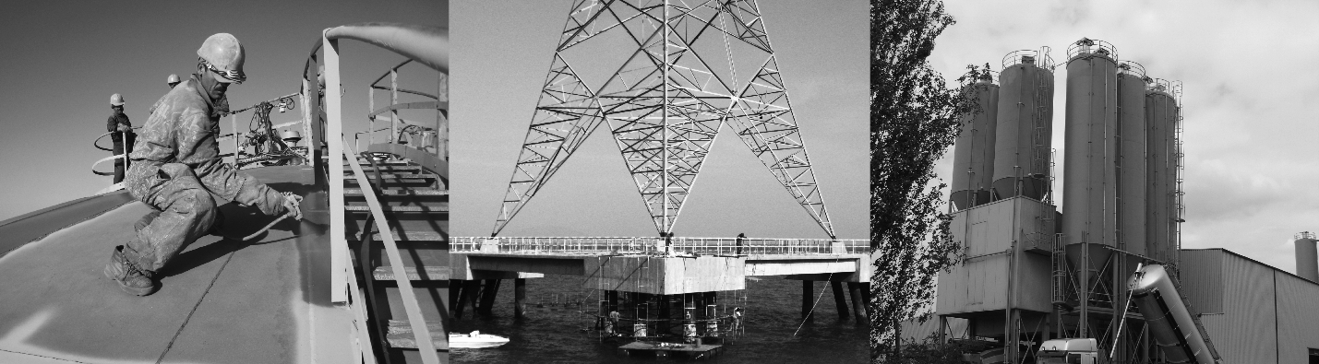
NSF/ANSI/CAN 61
Certification for contact with potable water
www.zinga.eu

Slide 2
Content
What is NSF/ANSI/CAN 61
Benefits of certification
Certification to ZINGA® & ZINGALU
Links

Slide 3
What is NSF/ANSI/CAN 61
NSF is an international, independent, non-profit, non-governmental organization that is dedicated to being the leading global provider of public health and safety-based risk management solutions.
The certification of NSF/ANSI/CAN 61 cover specific materials or products that come in contact with drinking water, drinking water treatment chemical, or both.
NSF/ANSI/CAN 61 testing covers all products with drinking water contact from source to tap and determines what contaminants may migrate or leach from your product into drinking water. It also confirms if they are below the maximum levels allowed to be considered safe.

Slide 4
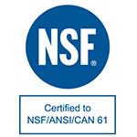
Benefits of certification
Meets the regulatory requirements for the U.S and Canada
Fulfill the testing requirements for many countries
International recognized by market leaders
Certification allows the company to:
  List the product in the online directory
  Use the NSF certification mark on your product and promotional materials

Slide 5
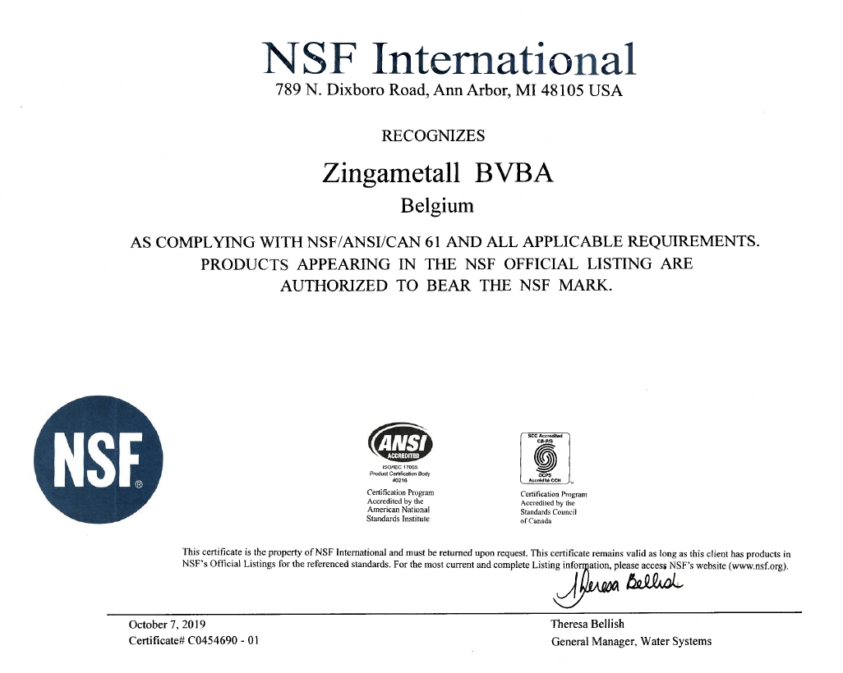
Certification of ZINGA® & ZINGALU
Zingametall is certified by NSF for ZINGA® & ZINGALU

Slide 6
Certification of ZINGA® & ZINGALU
Structure size and coating thickness restrictions
Structure | Product | Max. coating thickness | Water contact size Restriction
Pipe | ZINGA® | 150 µm | diameter >= 2133 mm
 | ZINGALU | 150 µm | diameter >= 914 mm
Tank | ZINGA® | 150 µm | volume >= 75708 liter
 | ZINGALU | 150 µm | volume >= 11356 liter

Slide 7
http://www.nsf.org/certified-products-systems
Certifications found on the distributor page: https://www.zinga.eu/downloads/
Links

